Slide 1
Convolutional Neural Network
Atikul Islam Sajib

Slide 2
Contents
Architecture of CNN
Padding
Strides
Muliple Input and Output Channels
Pooling
LeNet

Slide 3
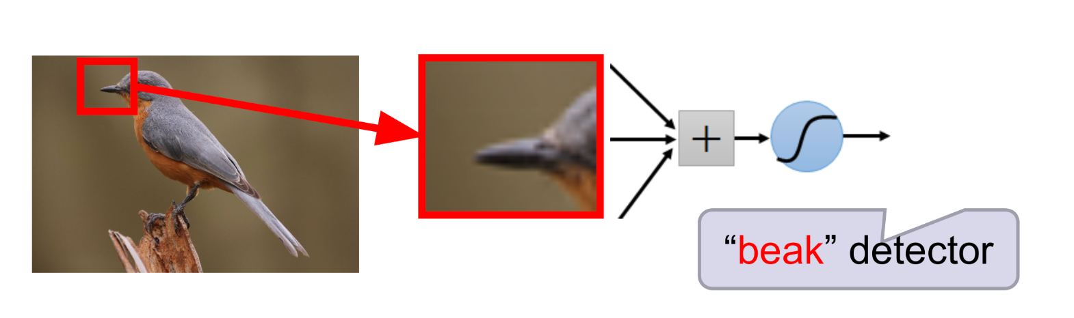
Why ANN not used?
High Computation Cost
Overfitting
Loss of important information like spatial arrangement of pixel

Slide 4
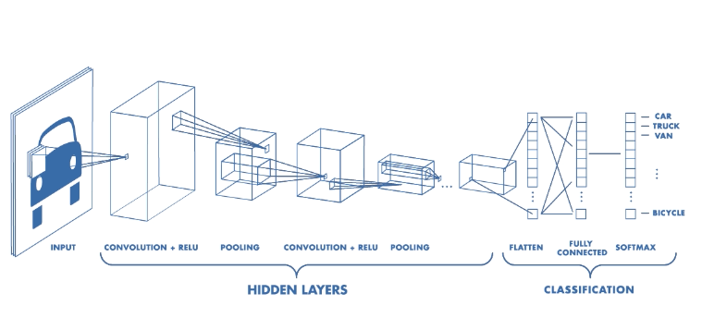
Architecture of CNN
Source: Google

Slide 5
Convolution Operation
Source: Google

Slide 6
Calculation of Feature Map
Image size (6*6), kernel size (3*3), what is the outcome of feature map?
The result of feature map : ((6-3)+1)*((6-3)+1) = (4*4)
Disadvantage:
Changed the shape with respect to original image and features map

Slide 7
Padding
Source: Google

Slide 8
Effect of Padding
Shape of feature map will be equivalent
Preserve information that is present at the borders of input data and present there only
It speeds up the calculation in comparison with scaling, resulting in better computational efficiency

Slide 9
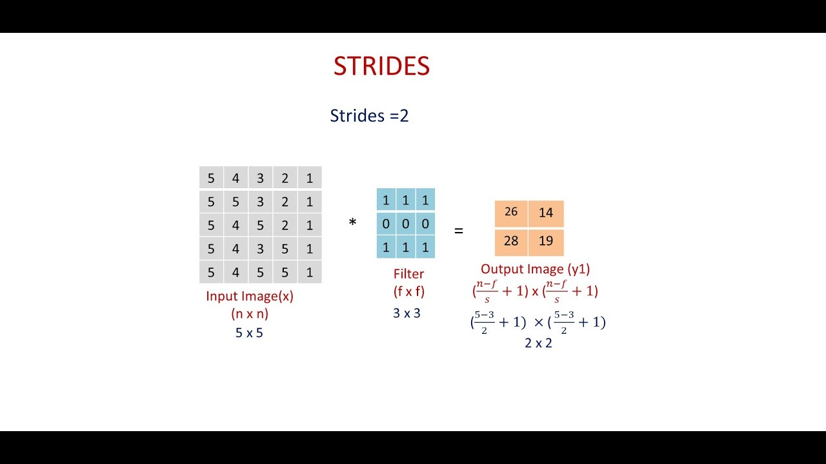
Strides
Source: Google

Slide 10
Strides Continued...
Source: Google

Slide 11
Pros and Cons of Strides
Loss of information
Focusing on high level features
Make training faster

Slide 12
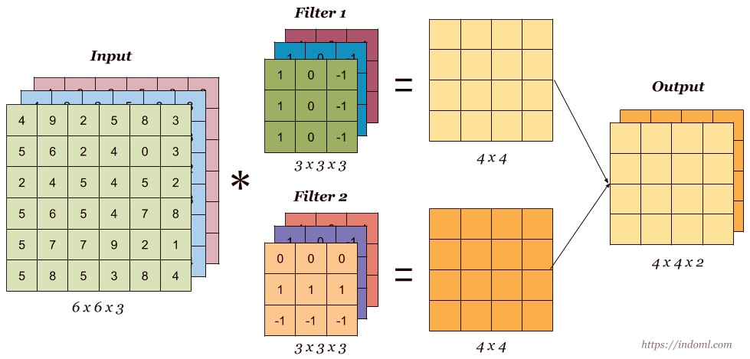
Multiple Input and Output Channels
Source: Google

Slide 13
Pooling Layer
Types of pooling layer:
Max pooling
Min pooling
Average pooling
Global pooling

Slide 14
Pooling Continued...
Source: Google

Slide 15
Effect of Using Pooling Layer
Make the training faster
Focusing on high level features
Prevent translation invarience problem
Distort of changing the shape of feature map

Slide 16
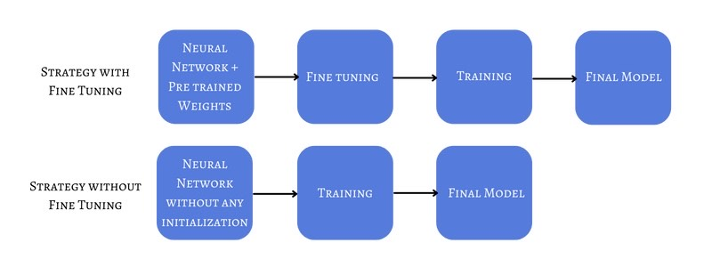
Transfer Learning
Pretrained Model
LeNet
AlexNet
VGG16
ResNet
InceptionNet
MobileNet
Fine tuning
Source: Google

Slide 17
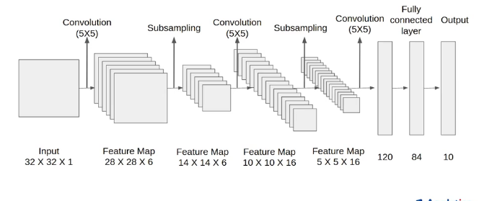
LeNet Architecture
Source: Google

Slide 18
References
https://towardsdatascience.com/convolutional-neural-network-cnn-architecture-explained-in-plain-english-using-simple-diagrams-e5de17eacc8f
https://medium.com/@draj0718/convolutional-neural-networks-cnn-architectures-explained-716fb197b243
https://en.m.wikipedia.org/wiki/Convolutional_neural_network

Slide 19


